Slide 1
Seattle Data AI Security Hackathon Team 4

Slide 2
Topic: AI-Powered Multi-Agent Tutoring System
Enhancing Learning through AI Collaboration
Members
Megha Narendra Simha
Neha Arora
Pratham Balaji
Eshwar
AI-Powered Multi-Agent Tutoring System​
cing Learning through AI Collaboration

Slide 3
Agenda
Introduction
Problem Statement
Solution Overview
System Architecture and Technologies Used
Key Features, Use case and Impact
Challenge and Future Work
Final tips & takeaways

Slide 4
Introduction
Overview of the Project:
This project aims to create an AI-powered tutoring system designed to offer personalized learning experiences for students.
It leverages multi-agent collaboration where different AI agents (instructors, peers, and progress trackers) work together.
Purpose:
To enhance traditional tutoring methods by integrating AI-driven, scalable learning solutions.
Allow for interdisciplinary connections between different subjects, aiding students in their learning journey.

Slide 5
Problem Statement
Challenges in Traditional Tutoring:
Traditional tutoring can be time-consuming, resource-intensive, and often lacks scalability.
Limited capacity for personalized learning paths for each student.
Need for Scalable Learning Solutions:
With increasing class sizes and diverse student needs, a scalable solution is crucial.
AI can automate personalized learning paths for each student, making it more efficient.
How AI Can Help:
AI allows for real-time adaptability, helping the system provide specific content based on a student's learning pace and style.
AI agents can identify gaps in students' knowledge and suggest appropriate interventions.

Slide 6
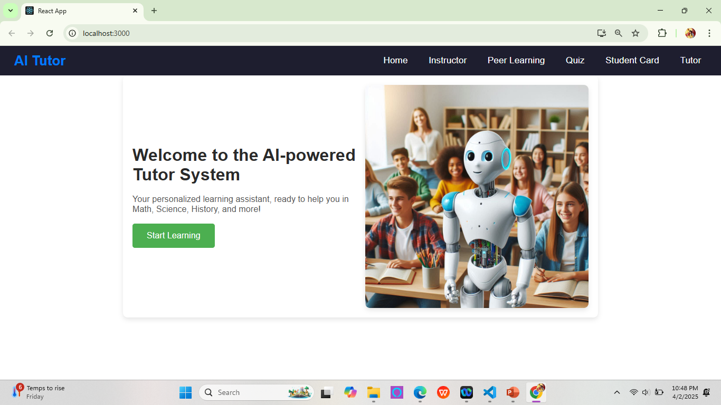
Home Page
The starting point for students and instructors to navigate through the different sections of the system and access personalized content based on their needs.

Slide 7
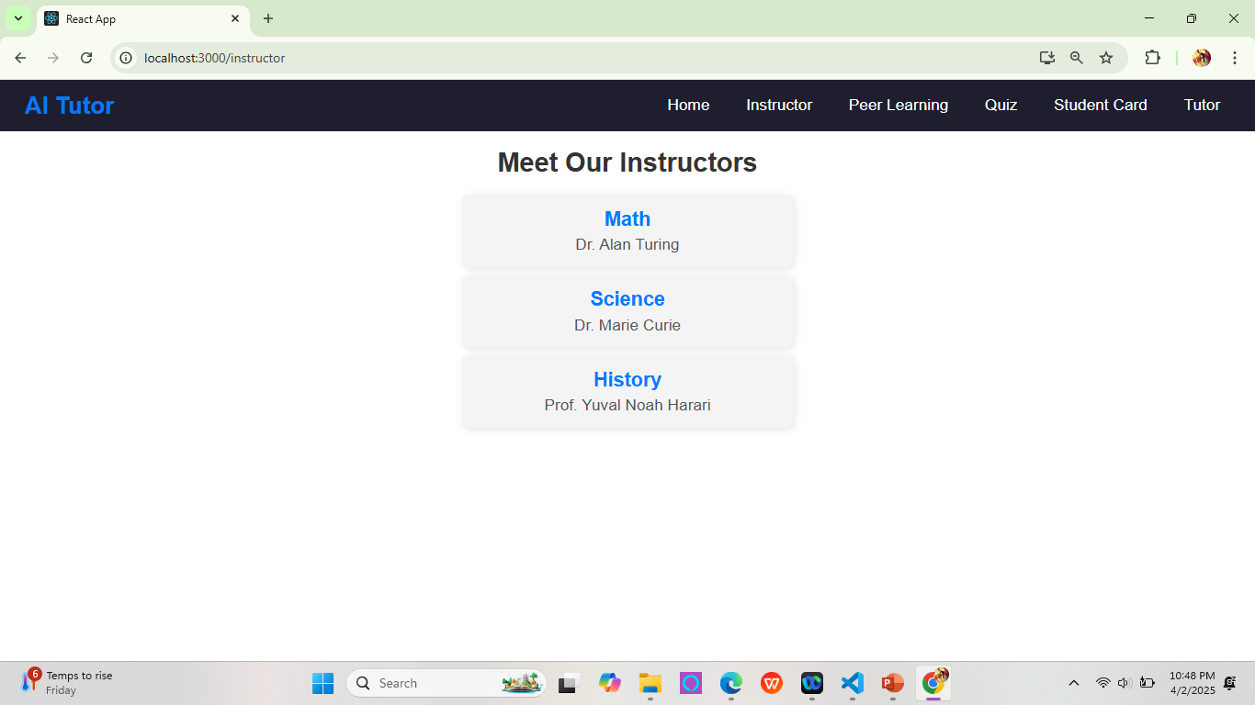
Instructor Page
Displays a list of available instructors, allowing students to choose an instructor based on their expertise, availability, and subjects of interest.

Slide 8
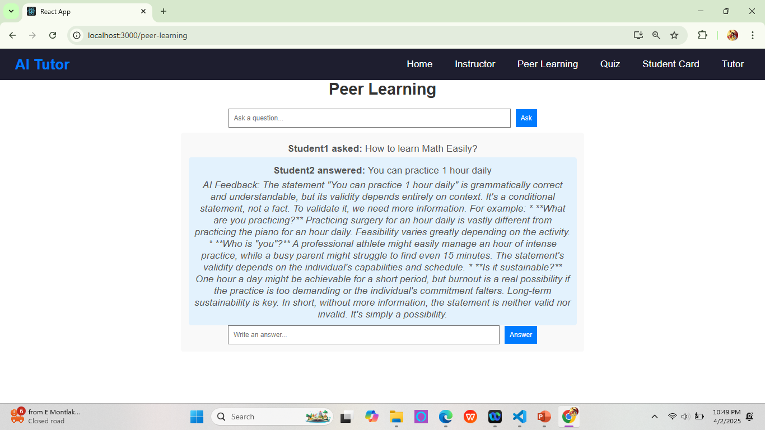
Peer Learning Page
Students can post questions they have on the peer learning page. Other students can contribute answers, while AI can provide additional guidance or clarification when needed.

Slide 9
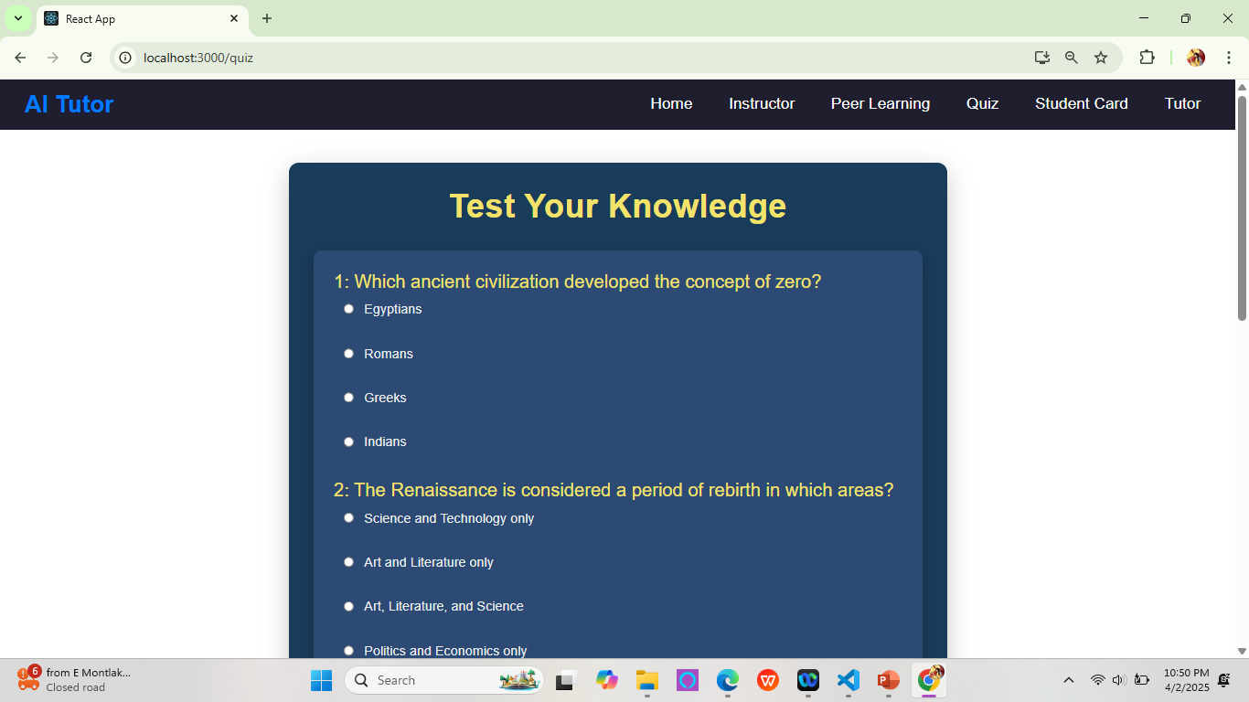
Quiz Page
The quiz page allows students to test their understanding of topics with dynamic, personalized quizzes, receiving instant feedback and recommendations based on their performance.

Slide 10
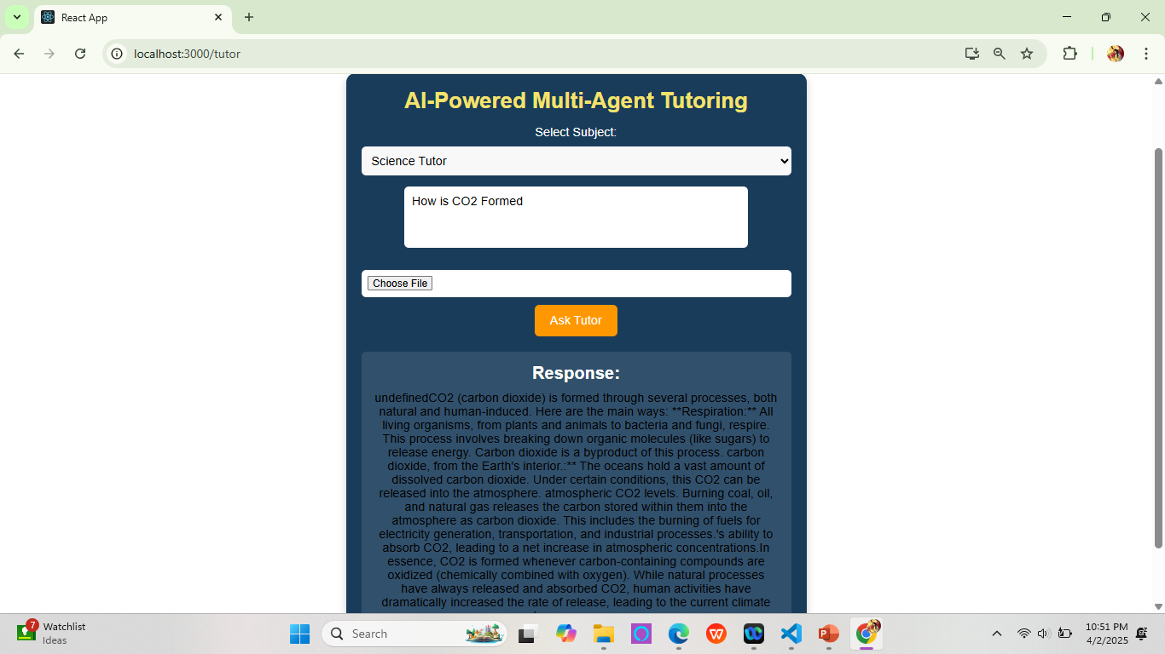
AI Tutor Page
Students can ask specific questions, and the AI tutor provides instant, tailored responses and explanations to help the student better understand the topic.

Slide 11
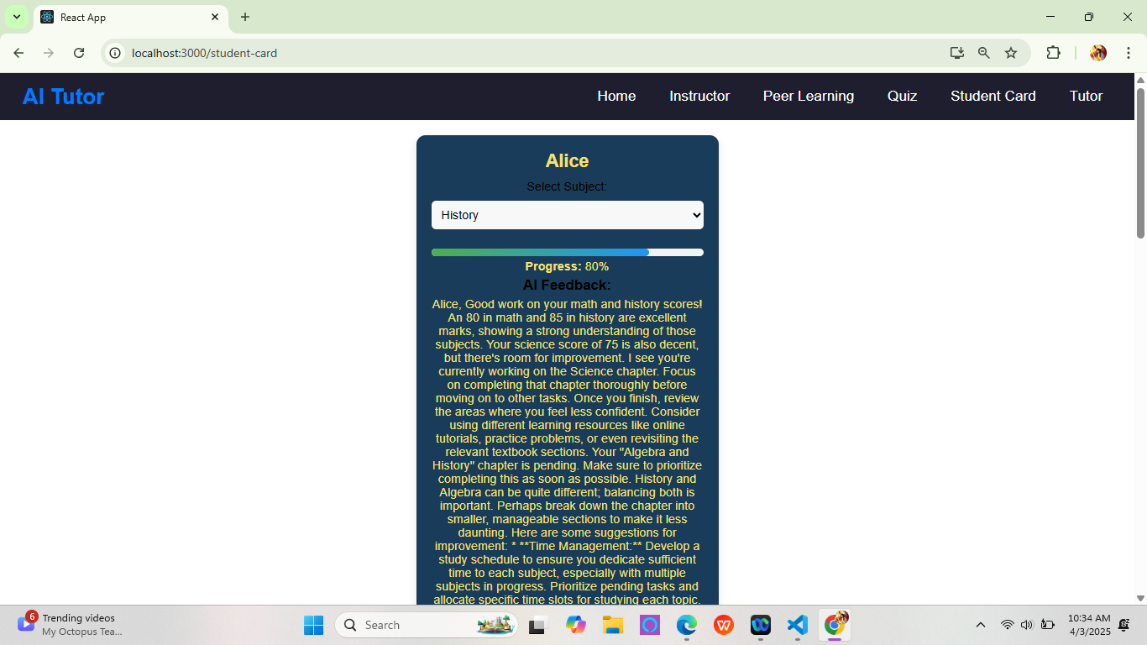
Student Card Page
Displays personalized AI-driven insights into the student’s progress, strengths, and areas needing improvement, offering suggestions for further study based on performance.

Slide 12
System Architecture and Technologies Used
AI Tutors: Multi-agent system for Math, Science, and History tutoring.
Student Interaction: Students post questions, receive AI-generated answers with feedback.
Quiz Generation: AI-powered quiz creation and answer validation.
Multimodal Inputs: Supports text, image, and PDF uploads for AI-assisted learning.
Student Card:allows students to receive AI-generated feedback and interdisciplinary learning suggestions based on their recent activities and academic progress in different subjects. Technologies:
Backend: Flask API for requests (questions, quizzes, progress, uploads).
AI Engine: Google Gemini AI for tutoring, validation, and quiz generation.
Frontend: React for interactive UI and student engagement.

Slide 13
Key Features, Use case and Impact
AI Tutoring & Peer Learning: Personalized AI tutors with Q&A and feedback.
Quiz Generation: AI-powered quizzes for continuous learning.
Multimodal Support: Handles text, images, and PDFs for diverse learning.
Feedback on Student Progress and Activity
Use Case: Personalized learning and assessment for students across subjects.
Impact: Improves learning outcomes, engagement, and academic progress.

Slide 14
Challenges and Future Work
Scalability: Handling large user base and data for real-time interactions.
AI Accuracy: Ensuring consistent quality and relevance of AI-generated content.
Multimodal Integration: Enhancing file processing for better context understanding.
Future Enhancements: Expand subject coverage, include voice support, and refine peer-learning features.

Slide 15
Final tips & takeaways
Emphasize the Impact:
Our AI-powered multi-agent tutoring system has the potential to transform education by offering personalized learning at scale.
The system not only helps students but also encourages peer collaboration and interdisciplinary connections between subjects.
Key Takeaways:
Scalability: The system can expand to support different subjects, making it adaptable to various educational contexts.
Engagement: The integration of peer learning and AI feedback enhances student engagement and improves learning outcomes.
Interdisciplinary Collaboration: AI agents foster connections across topics, promoting deeper understanding and a more holistic approach to learning.
Final Tip:
The success of this system lies in its ability to adapt to each student’s unique learning style while maintaining real-time, intelligent interactions.
Call to Action:
We are excited to take this prototype forward, refine the system, and implement it on a larger scale in educational settings.

Slide 16
Thank you
Team 4

